Slide 1
What makes someone a hero?
The Absolute True Diary of a Part-Time Indian
By Sherman Alexis

Slide 2
Nelson Mandela South African Anti-Apartheid political leader
Is this person considered a hero?

Slide 3
Martin Luther King Jr. A leader in the civil rights movement in the USA in the 1950s.
Is this person considered a hero?

Slide 4
Christopher Columbus Explorer, navigator, colonist who discovered Central America
Is this person considered a hero?

Slide 5
Anne Frank An author who died during the Holocaust
Is this person considered a hero?

Slide 6
Bill Gates Investor, author, philanthropist, humanitarian, founder of Microsoft.
Is this person considered a hero?

Slide 7
Princess Diana Public figure, Activist, Charity work
Is this person considered a hero?

Slide 8
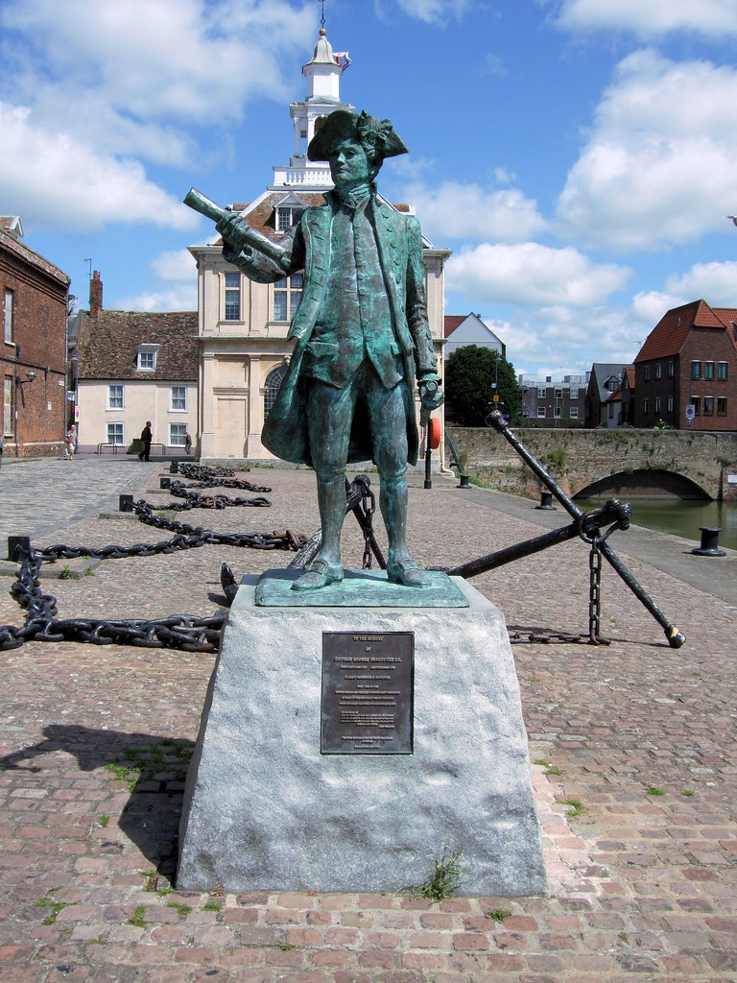
Captain Vancouver English navigator who surveyed the Pacific coast of North America
Is this person considered a hero?

Slide 9
John A. Macdonald First Prime Minister of Canada
Is this person considered a hero?

